Slide 1

DIABETIC RETINOPATHY USING CNN ALGORITHM
PROJECT MEMBERS
O. Glysia 20191A0401
K. Devendra 20191A0409
S. Noorulla 20191A0456
B. Hemanth 20191A0460
S. Noor Basha 21195A0407
Under the esteemed guidance of
Dr. SHAIK TAJ MAHABOOB M.Tech., Ph.D.
ASSOCIATE PROFESSOR & HEAD
DEPARTMENT OF ECE
JAWAHARLAL NEHRU TECHNOLOGICAL UNIVERSITY ANANTAPUR
COLLEGE OF ENGINEERING (AUTONOMOUS), PULIVENDULA

Slide 2

CONTENTS:
Abstract
Objective
Introduction
Algorithm
Dataset
Block Diagram
Advantages
Limitations & Software Requirements
Results
Conclusion
References

Slide 3
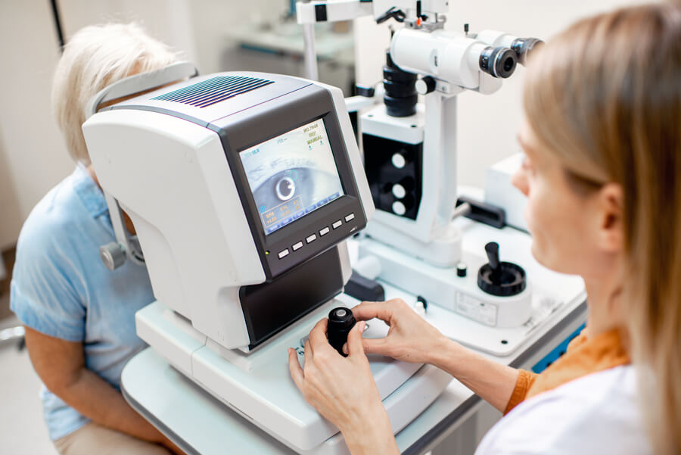
ABSTRACT:
The detection & diagnosis of the Diabetic Retinopathy is a difficult task.
Requires an experienced doctor for identification.
Deep learning technique is being used to overcome the issue.
A Convolutional Neural Network is used with a well trained model.
It improves the resulting accuracy, and through this classification technique, we can achieve high accuracy.
Fig.1. Treating a Retinal case

Slide 4
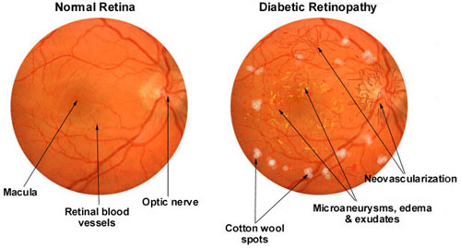
OBJECTIVE:
To develop a system for detection and classification of diabetic retinopathy from the retinal image with wide range of classification and maximum accuracy.
Fig.2. Images of Retina

Slide 5
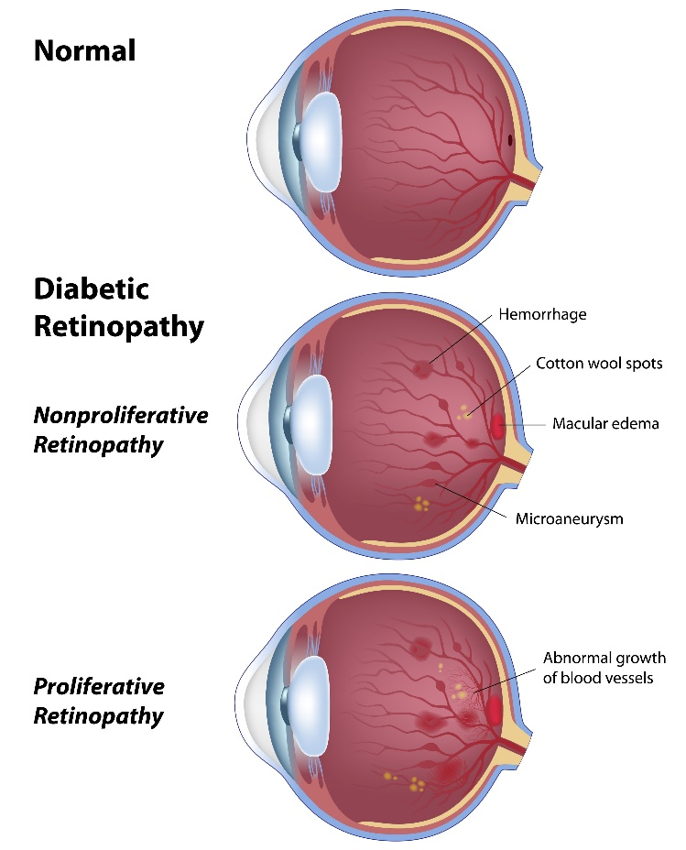
INTRODUCTION:
Diabetic retinopathy is a complication of diabetes affecting the eyes.
Leading cause of blindness in working-age adults.
Causes damage to retinal blood vessels due to high blood sugar levels.
Progresses from non-proliferative to proliferative diabetic retinopathy.
Blurred vision, floaters, impaired color vision, and vision loss are the impacts.
Laser therapy, anti-VEGF injections, surgery for severe cases are treatments.
Fig.3. Diabetic Retinopathy

Slide 6
ALGORITHM:
1. Import essential libraries:
Import TensorFlow, Keras, NumPy, Scikit-learn and Matplotlib libraries.
2. Assign Data paths
3. Data Exploration:
Use Exploratory Data Analysis (EDA), a fundamental step in the data analysis process
EDA helps in understanding the main characteristics of the dataset like count of images per class.

Slide 7
ALGORITHM:
4. Data Preprocessing:
Use the 'ImageDataGenerator' framework which
1. Rescales pixel values,
2. Adjusts Shear range,
3. Adjusts Zoom range,
4. Applies Horizontal flip,
5. Model Building:
Load InceptionV3 pre-trained model with ImageNet weights and freeze its layers.
Add a Flatten layer to the output of InceptionV3.
Create the final model by specifying input and output layers.

Slide 8
ALGORITHM:
5.1 INCEPTION V3:
Feature Extraction is specifically done by Inception V3 which is pre-trained on ImageNet dataset.
The architecture of Inception V3 includes symmetric and asymmetric building blocks
1. Convolution layers,
2. Pooling layers,
3. Concatenations,
4. Dropouts, and
5. Fully connected layers.
Batch normalization is extensively used in Inception V3 to improve training efficiency and performance.
Inception V3's inception modules consist of parallel convolutional pathways of different filter sizes.

Slide 9
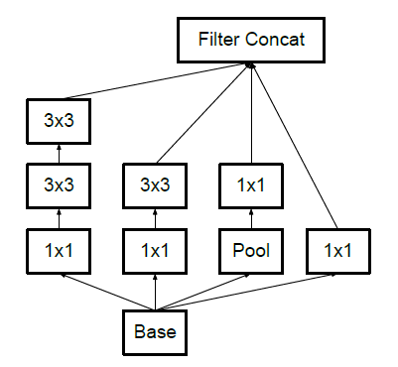
ALGORITHM:
5.1 INCEPTION V3:
Advantages of Inception V3 over predecessors:
Factorization into Smaller Convolutions
Spatial Factorization into Asymmetric Convolutions
Utility of Auxiliary Classifiers
Efficient Grid Size Reduction
Fig.4. Factorization in Inception V3

Slide 10
ALGORITHM:
6. Model Compilation and Training:
Compile the model with categorical cross-entropy loss, Adam optimizer, and accuracy metric.
Train the model using the training and validation generators for 50 epochs with specified steps per epoch and validation steps.
7. Model Evaluation:
Plot training and validation loss over epochs using Matplotlib.
Plot training and validation accuracy over epochs using Matplotlib.
8. Model Saving:
Save the trained model as 'DRmodel_inception.h5' for future use.

Slide 11
ALGORITHM:
9. Image Processing and Prediction:
Define functions to load and preprocess images for prediction.
Make predictions on a sample image using the trained model and display the predicted class along with the image.
10. Final Output:
Display the predicted disease class for the sample image.

Slide 12
DATASET:
Dataset Name : Diabetic Retinopathy Dataset.
Source : Kaggle platform.
The dataset contains 1917 Eye Fundus images.
Sub-folders (Types of DR) :
1. Normal - 328 Images
2. Mild - 406 Images
3. Moderate - 385 Images
4. Severe - 315 Images
5. Proliferative - 483 Images

Slide 13
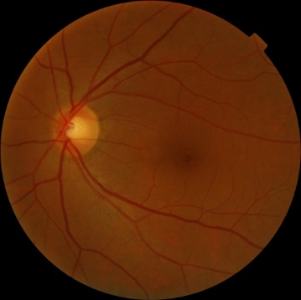

BLOCK DIAGRAM:
Preprocessing
Rescaling
Shear Range
Zoom
Horizontal Flip
Input Image
(Fundus Image)
Type of DR present
Convolutional Neural Network (Inception V3)
Output
Classification and Detection
Knowledge Basis
Fig.5. Block Diagram of the Process

Slide 14
ADVANTAGES:
High Accuracy: Achieves high accuracy rates, with models reaching up to 95% accuracy after training on dataset of fundus images
Efficient Deployment: Offers a lightweight and efficient model that can be deployed easily with an accuracy of almost 95% according to results obtained.
Automated Detection: Reducing the need for manual examination by ophthalmologists and streamlining the diagnostic process.
Enhanced Diagnosis: Provides a reliable method for diagnosing Diabetic Retinopathy, offering impressive sensitivity and specificity in detecting the severity of the condition

Slide 15
LIMITATIONS:
Misclassification Risk: There is a risk of misclassification in automated diagnosis
Human Supervision Requirement: Due to its high sensitivity, it may lack the precision. So the presence of a professional is required.
SOFTWARE REQUIREMENTS:
Jupyter Notebook
Anaconda Navigator

Slide 16
APPLICATIONS:
Patient Monitoring:
Facilitates regular monitoring of diabetic patients' retinal health
Enables healthcare providers to track disease progression and adjust treatment plans accordingly.
Telemedicine:
Diabetic retinopathy classification models support telemedicine initiatives by enabling remote screening and diagnosis of patients.
Research and Clinical Trials:
Accurate classification of diabetic retinopathy facilitates research efforts and clinical trials

Slide 17
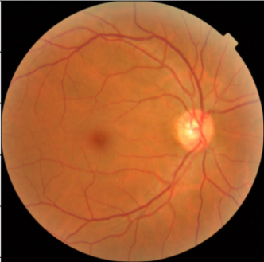
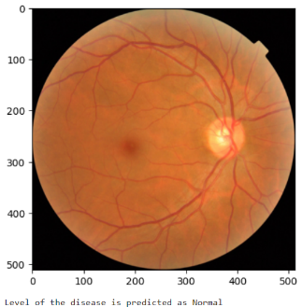
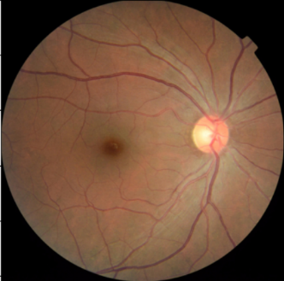
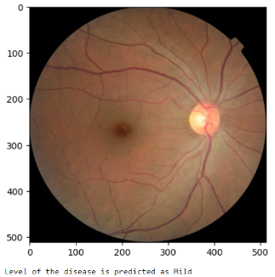
RESULTS:
Following are the some results acquired during evaluation:
INPUT
EXPECTED
ACTUAL
NORMAL
(NORMAL)
MILD
(MILD)

Slide 18
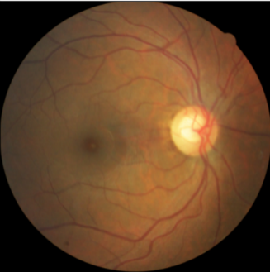
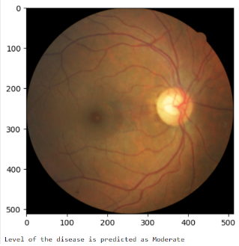
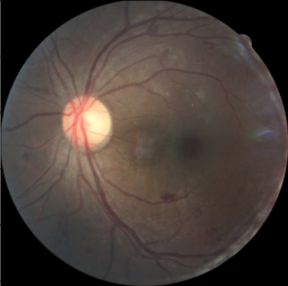
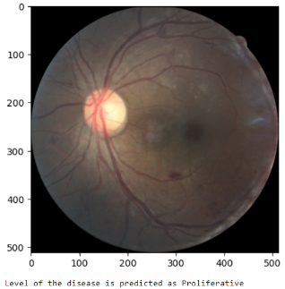
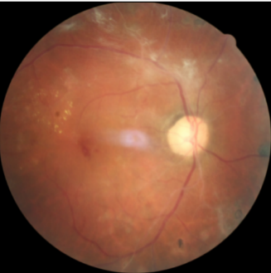
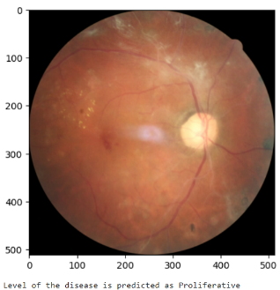
RESULTS:
INPUT
EXPECTED
ACTUAL
MODERATE
(MODERATE)
SEVERE
(PROLIFERATIVE)
PROLIFERATIVE
(PROLIFERATIVE)

Slide 19
RESULTS:
The prediction accuracy of the model at different cases, When total number of images are 1917 :
CASE | Training Images | Test Images | Accuracy(%)
I | 163 | 1754 | 90.99
II | 217 | 1700 | 94.82
III | 770 | 1147 | 95.55
IV | 958 | 959 | 98.54
Table 1. Accuracy percentage
Rate of Acceptance and Rate of Rejection includes:
True Acceptance: True acceptance occurs when a positive instance is correctly classified as positive by the system.
True Rejection: True rejection occurs when a negative instance is correctly classified as negative by the system.
False Acceptance: False acceptance occurs when a negative instance is incorrectly classified as positive by the system.
False Rejection: False rejection occurs when a positive instance is incorrectly classified as negative by the system.

Slide 20
RESULTS:
The model got an accuracy of 90.99 % when 163 and 1754 images are given as Training and Testing data respectively i.e., 8 - 92 percentage.
The Rate of Acceptance (ROA), Rate of Rejection (ROR) is depicted as follows:
CASE 1 | True | False
Acceptance | 838 | 74
Rejection | 758 | 84
Table 2. ROA & ROR table – Case 1

Slide 21
RESULTS:
The model got an accuracy of 94.82 % when 217 and 1700 images are given as Training and Testing data respectively i.e., 12-88 percentage.
The Rate of Acceptance, Rate of Rejection is depicted as follows:
CASE II | True | False
Acceptance | 820 | 34
Rejection | 792 | 54
Table 3. ROA & ROR table – Case 2

Slide 22
RESULTS:
The model got an accuracy of 95.55 % when 770 and 1147 images are given as Training and Testing data respectively i.e., 40-60 percentage.
The Rate of Acceptance, Rate of Rejection is depicted as follows:
CASE III | True | False
Acceptance | 574 | 12
Rejection | 522 | 39
Table 4. ROA & ROR table – Case 3

Slide 23
RESULTS:
The model got an accuracy of 98.54 % when 959 and 958 images are given as Training and Testing data respectively i.e., 50-50 percentage.
The Rate of Acceptance, Rate of Rejection is depicted as follows:
CASE IV | True | False
Acceptance | 458 | 25
Rejection | 433 | 43
Table 5. ROA & ROR table – Case 4

Slide 24
CONCLUSION:
Effective Model Training: Trained the Inception V3 model successfully.
High Accuracy: Model testing yielded accurate predictions for Diabetic Retinopathy.
Clinical Utility: Model can now predict Diabetic Retinopathy in fundus images, aiding early detection.
Healthcare Impact: Offers potential for efficient diagnosis and timely intervention in healthcare settings.
Future Development: Opportunities for refining the model to enhance diagnostic capabilities and improve patient outcomes.

Slide 25
REFERENCES:
Evans, J., Rooney, C., Ashwood, F., Dattani, N., Wormald, R.. Blindness and partial sight in England and Wales: April 1990-march 1991. Health Trends 1996;28(1):5–12.
Kocur, I., Resnikoff, S.. Visual impairment and blindness in europe and their prevention. Brit J Ophthalmol 2002;86(7):716–722.
Sector, S.P., et al. State of the nation 2012. Diabetes UK 2013;.
Sculpher, M., Buxton, M., Ferguson, B., Spiegelhalter, D., Kirby, A.. Screening for diabetic retinopathy: A relative cost-effectiveness analysis of alternative modalities and strategies. Health Econ 1992;1(1):39–51.
Benbassat, J., Polak, B.C.. Reliability of screening methods for diabetic retinopathy. Diabetic Med 2009;26(8):783–790.

Slide 26
THANK YOU

